Slide 1
DBSL Mini Project
Presented By:
31106 Atharva Khadilkar
31115 Vedant Bothikar
31118 Shubham Chemate

Slide 2
CONTENTS
Problem Definition
Purpose
Scope
Objectives
Motivation
Project
Schema
Tech Stack

Slide 3
Problem Definition
To build a software of hotel management system that will help hotel owners to room availability easily.
Book a room, add details of guests and maintain a record of everything.

Slide 4
Purpose
The purpose is to provide design details of the Hotel Management software to allow hotel owners and system developers to have documents of reference.

Slide 5
Scope
The product is a software, used to manage daily room booking which includes
Showing available & occupied rooms
Status of employees & rooms
Login system

Slide 6
Objectives
User friendly
One of our objectives is to provide a user-friendly system for hotel owners to manage rooms & guest information in a single software
Replacing traditional methods
Along with this, our software also aims to replace traditional methods of maintaining registers with information

Slide 7
Motivation
Hotel owners face a lot of issues for maintaining information of available rooms along with guest details.
Traditional methods, many a times, prove to be inefficient.
There’s a need to improve the system & increase productivity

Slide 8
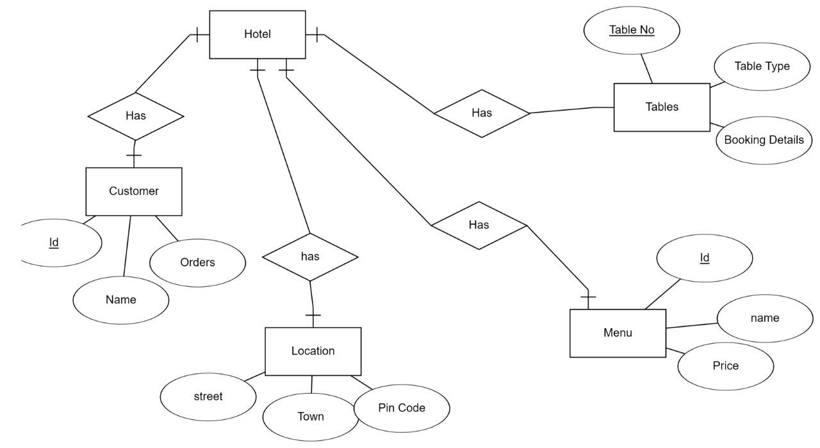
Project

Slide 9
Schema
01
02
Employee
Room
name varchar(30),
age varchar(10),
gender varchar(15),
job varchar(30),
salary varchar(20),
phone varchar(15),
aadhar varchar(15),
email varchar(50)
room_number varchar(10),
availability varchar(20),
status varchar(20),
price varchar(20),
bed_type varchar(20)

Slide 10
Schema
03
04
Driver
Customer
name varchar(100),
age varchar(10),
gender varchar(20),
company varchar(20),
brand varchar(20),
location varchar(40)
id varchar(100),
number varchar(20),
name varchar(100),
gender varchar(50),
country varchar(50),
room varchar(10),
status varchar(30),
deposite varchar(20)

Slide 11
Tech Stack
Java with MySQL
Thanks for your time!
31106 Atharva Khadilkar
31115 Vedant Bothikar
31118 Shubham Chemate

